Slide 1
Completing the Transition Engine Annual Report (TEAR)
Off-Road Compression-Ignition Emission Regulations
Regulatory Administration Section
Transportation Division

Slide 2
Disclaimer
The following information is intended for guidance only. It does not in any way supersede or modify the requirements of the Canadian Environmental Protection Act, 1999 (CEPA) or the Off‑Road Compression‑Ignition Engine Emission Regulations (Regulations) made under the CEPA. In the event of inconsistency between this information and the CEPA and/or the Regulations, the CEPA and the Regulations shall prevail.

Slide 3
Who needs to submit a TEAR?
If you import transition engines or machines containing a transition engine into Canada, or are a Canadian manufacturer of transition engines or machines containing a transition engine, you must submit a transition engine annual report (TEAR) as set out in section 13.1 of the Regulations.
  A transition engine is an engine that meets a previous emission standard as set out in Section 13 of the Regulations.
For transition engines imported or manufactured during the 2018 calendar year, the report must be submitted no later than March 31, 2019.

Slide 4
Suggested Template
The latest version of the template (vers.18-2-r0) was distributed along with this slideshow. We recommend you use this version of the template.
It is important to have the latest version of the template to ensure that
  the guidance provided is the best available; and
  the information entered is properly validated.

Slide 5
Completing the TEAR
Step 1: Open and save the template on your computer.
Upon opening, you may need to click “Options” or “Enable Content” near the top of your screen to ensure Excel Macros are enabled for this workbook
  The workbook will not function as intended if Excel Macros are not enabled
Step 2: After you have read the disclaimer, click the button at the bottom.

Slide 6
New Email Address
If you are using a previous version of the template, please take note of the Regulatory Administration Section’s new email address:
ec.VehicleAndEngineInfo.ec@canada.ca
The email addresses, indicated on older versions of the template, are no longer valid. Upon completion, please submit the report to the new email address.

Slide 7
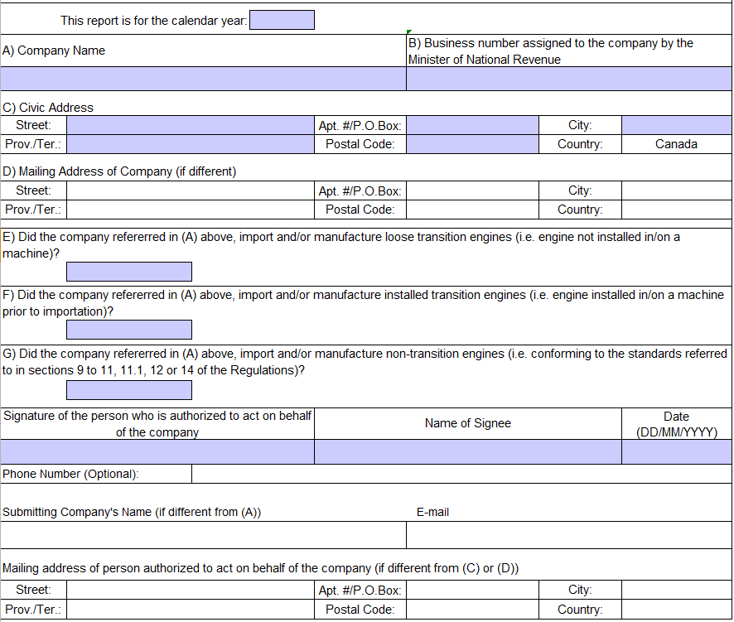
Introduction Worksheet
Step 3: Complete all required fields (cells highlighted in purple).

Slide 8
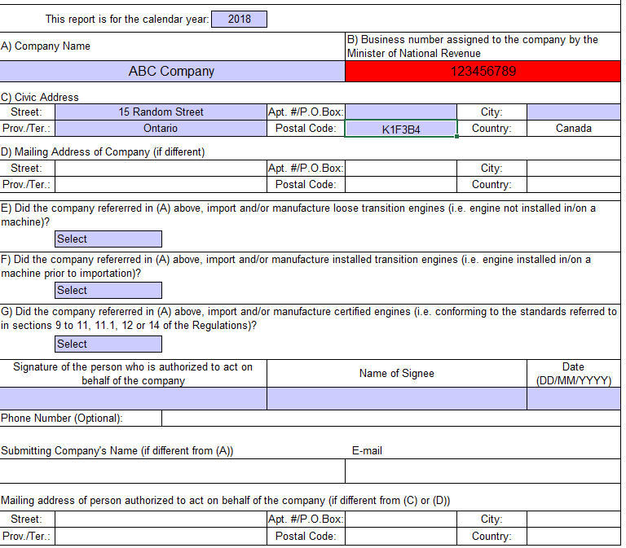
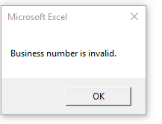
Introduction Worksheet (cont’d)
Invalid entries will be highlighted red.
Example:
If the nine‑digits business number (assigned to the company by the Minister of National Revenue) is entered incorrectly or is invalid, an error message will be shown and the cell will be highlighted red.

Slide 9
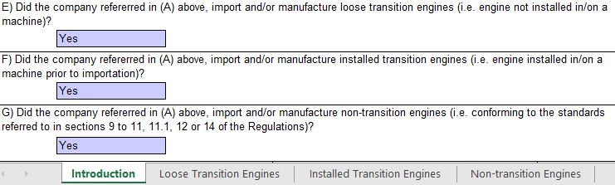
Introduction Worksheet (cont’d)
Responses to sections E, F and G help determine which details of the imported engines are required.
  Answering “Yes”, as applicable, will cause a relevant worksheet to appear as a tab at the bottom of the window.

Slide 10
Engine Detail Worksheets
Step 4: Click on each worksheet tab that appear near the bottom of your screen to complete information, as applicable, with respect to:
Loose Transition Engines:
  Transition engines not installed in/or on a machine
Installed Transition Engines
  Transition engines installed in/or on a machine
Non-transition Engines include:
  certified engines
    engines meeting current emission standards (Tier 4) or the standards in place at the time of their manufacture,
  replacement engines,
  transportation refrigeration units, or
  engines that do not meet current emission standards but that conform to the certification and in-use standards in the EPA certificate

Slide 11
Emission Standards
Consult Chapter F of the guidance document for information on the emission standards for engines subject to the Regulations. The guidance document is available at http://www.ec.gc.ca/lcpe-cepa/default.asp?lang=En&n=0CBF3BCC-1&offset=3&toc=show%20-%20toc3-11
  Emission standards → Chapter F → Tables 2 to 5
  Transition engines timeframes → Chapter F → Table 6
The validation properties of the workbook will also assist in determining if a particular engine is a transition engine or a non-transition engine.
If you imported both transition and non-transition engines in 2018, you are required to also include the non-transition engines in your TEAR report.

Slide 12
Certified Engines
Engines meeting final Tier 4, or
Engines meeting the emission standards in place at the time of their manufacture, listed in the tables below, depending on the model year and power category.
 | << Tier 2 >> | << Tier 3 >>
Power (kW) | Model Year | Model Year
<8 | 2006–2011 | n/a
>8<19 | 2006–2011 | n/a
>19<37 | 2006–2011 | n/a
>37<75 | 2006–2007 | 2008–2011
>75 <130 | 2006 | 2007–2011
>130<560 | n/a | 2006–2011
>560 | 2006– 2011 | n/a
<< interim Tier 4 >>
Power (kW) | Model Year
≥19<37 | 2012
≥37<56 | 2012
≥56<75 ª | 2012–2013
≥75<130 ª | 2012–2013
≥130≤560 | 2012–2013
>560≤900 | 2012–2014
>900 | 2012–2014
ª For the 2011 model year, the Tier 3 standards apply

Slide 13
Transition Engines Timeframes
Engines meeting either of the previous-tier standards (e.g. Tier 3, or the interim Tier 4 standards)
Power (kW) | Applicable model years¹ | Emission Standard | End of general availability provisions
56 ≤ kW < 75 | 2012+ | Tier 3 | Dec 31, 2018
75 ≤ kW < 130 | 2012+ | Tier 3 | Dec 31, 2018
Power (kW) | Applicable model years¹ | Emission Standard | End of general availability provisions
19 ≤ kW < 37 | 2013+ | Interim Tier 4 | Dec 31, 2018
37 ≤ kW < 56 | 2013+ | Interim Tier 4 | Dec 31, 2018
56 ≤ kW < 75 | 2014+ | Interim Tier 4 ² | Dec 31, 2020
75 ≤ kW < 130 | 2014+ | Interim Tier 4 ² | Dec 31, 2020
130 ≤ kW ≤ 560 | 2014+ | Interim Tier 4 ² | Dec 31, 2020
kW > 560 | 2015+ | Interim Tier 4 | Dec 31, 2021
¹Previous model years are not considered transition engines
² Phase-out

Slide 14
Transition Engines
Transition engines must be installed in or on a machine before the end of the set time frames (indicated in the transition engine timeframe tables)
If you have loose transition engines in Canada that are not installed into machines before the end of the applicable time frames, your options may include:
  exporting the engines to a place outside of Canada, if they meet the requirements of the destination country;
  selling the engines back to the engine manufacturer or vendor, if they accept them; or
  destroying the engines.

Slide 15
Engine Detail Worksheets (cont’d)
Enter all required details (cells highlighted in purple).
Drop-down lists are used for certain fields.
If you require more space on any worksheet, click on the ‘Add Table’ button available on the bottom of each worksheet.
If invalid information is entered, an error message will appear.
  Review the information and enter the correct data
    If you are still uncertain, and the workbook continues to show error messages or red cells, contact the Regulatory Administration Section (refer to Slide 25 for contact information).
After clicking “OK” on the error message, the cell with invalid entry will be highlighted red to indicate need for correction.
Do not submit a report with red fields.
  Reports submitted with red fields will be identified as “incomplete” or “non-compliant”

Slide 16
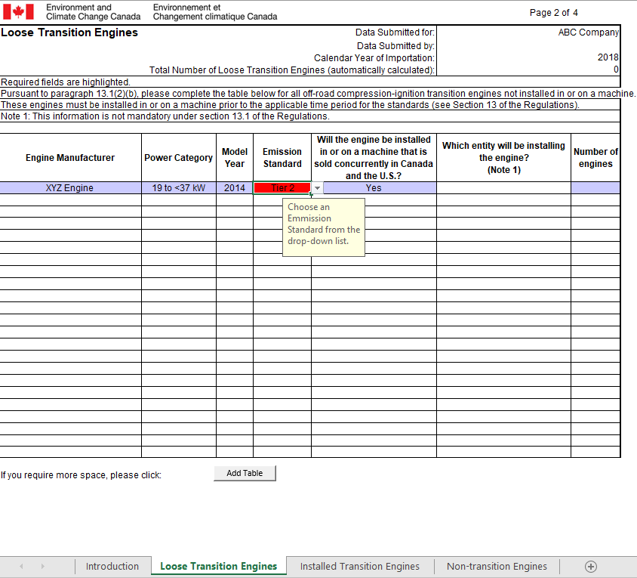
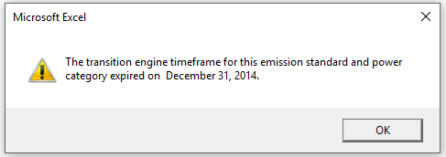
Error Example: Loose Transition Engines

Slide 17
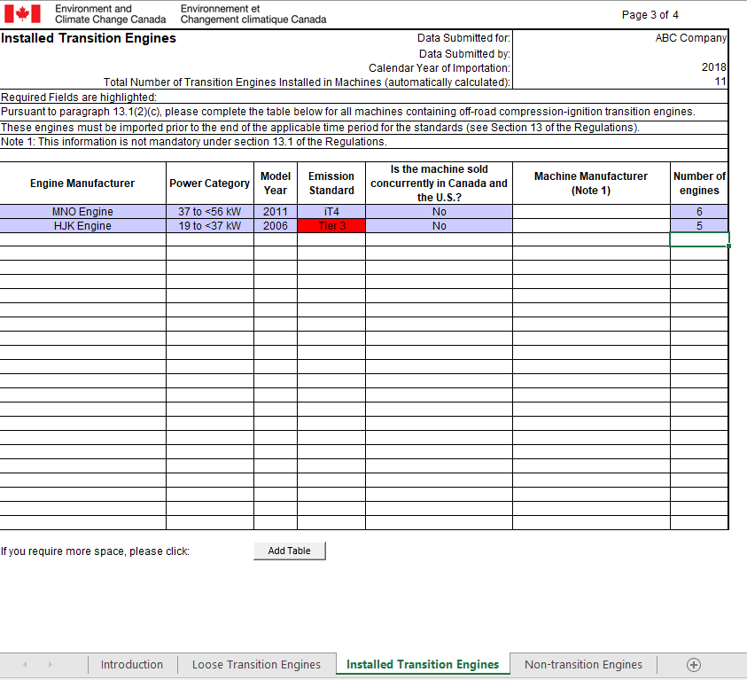
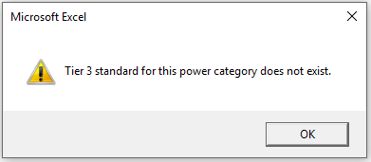
Error Example: Installed Transition Engines

Slide 18
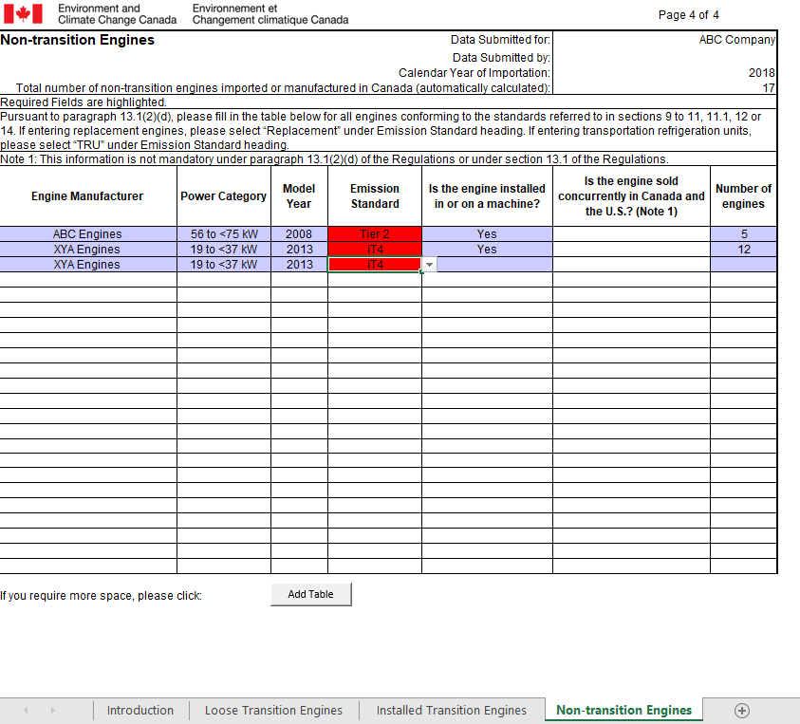
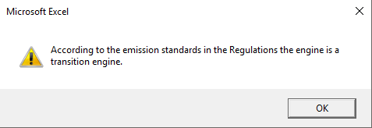
Error Example: Non-Transition Engines

Slide 19
Check Details with Declarations
Ensure that the details in your TEAR align with your company’s importation declarations submitted for that year
All engines/machines must be declared prior to importation. Therefore, the number of engines in your TEAR should correspond to those in the declarations for the same calendar year.

Slide 20

Sign and Submit
Step 5: Sign the report
    You may sign the report electronically; or
    Print the Introduction worksheet, sign where indicated, and scan it.
Step 6: Send an email to ec.VehicleAndEngineInfo.ec@canada.ca with the following attachments:
    the completed Excel workbook file, and
    a scan of the signed Introduction worksheet.

Slide 21
In Summary…
  Complete the transition engine annual report (TEAR) if, in 2018, you imported or manufactured transition engines for the purpose of sale.
Use the latest version of the template
  Enable Content/Macros and read the disclaimer
Complete the Introduction worksheet
  Fill in all required cells (in purple)
  Respond to sections E, F and G to activate applicable tabs
Complete the Loose transition engines, Installed transition engines, and/or Non-Transition engine worksheets, as applicable
  Correct errors if red flags appear
Validate TEAR with importation declarations
  Total number of engines and/or machines should match
Sign and submit the report to ec.VehicleAndEngineInfo.ec@canada.ca

Slide 22
Questions
  For questions related to your submission, please do not hesitate to contact:
  Regulatory Administration Section
  Transportation Division
  Environment and Climate Change Canada
  351 St. Joseph Boulevard
  Gatineau, QC K1A 0H3
  Phone number: 1-844-454-9017
  Email address: ec.VehicleAndEngineInfo.ec@canada.ca

Slide 23
Useful Links
  CEPA Environmental Registry
  http://www.ec.gc.ca/lcpe-cepa/default.asp?lang=En&n=D44ED61E-1
  Off-Road Compression-Ignition Engine Emission Regulations
  http://www.ec.gc.ca/lcpe-cepa/eng/regulations/detailReg.cfm?intReg=88
Guidance Document
http://www.ec.gc.ca/lcpe-cepa/default.asp?lang=En&n=0CBF3BCC-1
Importation Declaration Form
http://www.ec.gc.ca/lcpe-cepa/default.asp?lang=En&n=4FD6ECE2-1

