Slide 1
Customs Self Assessment
Offshore Policy Proposal
CSA Importer Members Forum
June 2013

Slide 2
Introduction
As requested by CSA Importers the CBSA has been working on the expansion of the CSA program to allow expedited processing for goods from offshore countries.
The offshore process must ensure a balance between the needs of CSA members and the mandate of CBSA.

Slide 3
Background – Expanding to Offshore
A CSA offshore proposal was prepared in 2009, following extensive research, consultation and the development of a detailed risk-mitigation strategy.
The proposal included obtaining complete Advanced Commercial Information (ACI) including cargo, crew and conveyance data for each shipment and an importer exemption from Advanced Trade Data (ATD).
CSA importers would provide all ATD elements in advance in the form of a profile, much like the current Trade Chain Partner (TCP) information is provided today.
This proposal represented a significant investment on the part of the CBSA and the process was considered cumbersome by importers.

Slide 4
CSA Offshore 2013 Proposal
The proposal was revisited in 2012-2013 in order to leverage new processes and technologies and align with the future direction of the CBSA:
  Full ATD will be provided for all offshore shipments with one exception for low risk goods – a text description can be provided in lieu of the HS tariff classification.
  Importers will have flexibility to use third parties to provide ATD.
  The HS tariff classification will still be required for clearance of goods with Other Government Department (OGD) requirements.
  Importers will not be required to provide a release package which is consistent with current CSA clearance process.

Slide 5
CSA Offshore Process
CSA Offshore
eManifest
ACI – Cargo, Crew and Conveyance data provided by carrier.
ACI – Cargo, Crew and Conveyance data provided by carrier.
ATD provided by importer or third party.
Data Elements provided:
  Manufacturer / Supplier
  Seller (Vendor)
  Exporter
  Importer Number
  Country of Origin
  Country of Export
  Text Description
  Buyer (Purchaser)
  Consignee
  Container Number
ATD provided by importer or third party.
Data Elements provided:
  Manufacturer / Supplier
  Seller (Vendor)
  Exporter
  Importer Number
  Country of Origin
  Country of Export
  Commodity Code (HS)
  Buyer (Purchaser)
  Consignee
  Container Number
Data is assessed by risk engine.
Data is assessed by risk engine.
Decision made by targeter to authorize for delivery or refer for health, safety and admissibility.
Decision made by targeter to release or refer for health, safety and admissibility.
Release package not required.
Release package required.

Slide 6
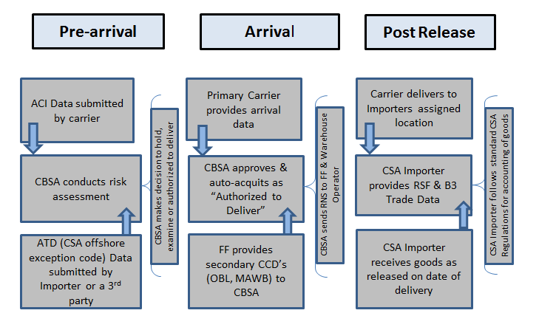
CSA Offshore Operational Flow

Slide 7
Benefits
Provides for a streamlined clearance model for all of a trusted importer’s shipments.
Provides a cost-saving benefit for trusted traders through the elimination of the requirement for a release package and the requirement to provide HS Classification in advance.
Better alignment of CBSA resources by focusing examination, risking and targeting efforts on goods of unknown and high risk.
Provide CSA importers with flexibility on how they provide ATD– they can choose to use a third party service provider.

Slide 8
Next Steps
  A final policy decision will be made on whether to proceed with the CSA offshore model so that implementation can be made in tandem with eManifest ATD requirements.
Regulatory changes will be required.

